Slide 1

Selling your Products and Services
AREC 213

Slide 2
Know Your Lemons
© Timothy J. Berry, Palo Alto Software 2007-2009. All rights reserved.
Notes:
Do Lemon Exercise: NAME YOUR COMPANY
COME UP WITH YOUR SALES PITCH FOR YOUR LEMONS AS PRESENTED TO A FOOD STORE BUYER.
Discuss how niche relates to value.
What niche does your business idea serve????

Slide 3
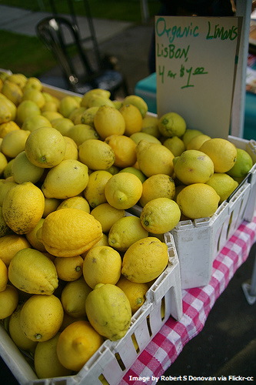
What Did We Learn?
© Timothy J. Berry, Palo Alto Software 2007-2009. All rights reserved.
Notes:
Possible answers:
Not all “lemons” are the same
Value is determined by customer perception
How you describe your idea (niche) determines customer value
The point of the Lemons exercise is to point out that you can be selling the same thing as the guy next to you but it all depends on how you niche your product, service, or idea. With the lemons it usually comes down to organic or not, local or not, taste, uses, name, footprint, etc. You will find that each group has identified different point to their lemon and as the food buyer there will be different things that appeal to you based on what your customers want. I usually use the example of the two goat's milk soap students in the same class. By the end, they had totally different groups they were appealing to with different features and benefits of their soaps: one was mainstream gifts while the other was healing formulas for skin problems.

Slide 4
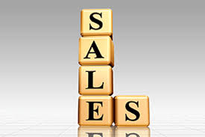
Owner’s Feature Sell!
Sellers pay more attention to the specific products they offer than to the benefits and experiences produced by the products.
Buyers want to buy what’s important to THEM!
Notes:
DISCUSS FEATURE SELLING VERSUS NEEDS BASED SELLING.

Slide 5
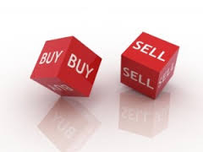
What is Selling?
Analyzing a customer’s need for a product, service, or idea.
Then providing persuasive information about product, service or idea to the customer.
Notes:
TRANSITION: ASK, HOW DO YOU KNOW WHAT WAS MOST IMPORTANT TO ME AS THE BUYER OF THESE LEMONS?

Slide 6
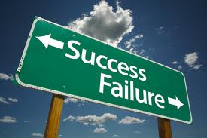
D. C. V. B. The secret formula!
“D” - Disadvantage
“C” – Consequence
“V” – Value
“B” – Benefit
Warning:
Using this process will qualify you as a “Salesperson”.
Notes:
EXPLAIN THIS PROCESS AND THE IMPORTANCE OF THE CUSTOMER UNDERSTANDING THE CONSEQUENCE OF THE DISADVANTAGE.
Use the example of a 500 page report needing to be prepared and the document feeder feature.

Slide 7
DISADVANTAGE
Ask the customer what is most important to them, in evaluating this product
What is the reason they are looking to buy

Slide 8
CONSEQUENCE
Ask the customer why this is important to them
This is when we find out how the problem or issue is impacting them

Slide 9
VALUE AND BENEFIT
Now you can sell them the value and benefit your product or service will provide to them in satisfying their buying need

Slide 10
Problem/Solution Exercise
On a piece of paper:
List one of your products or services
Describe the problem this product or service addresses
Describe the benefits of this product or service using the problem/solution methodology
Be prepared to read this to and sell the class!
Notes:
Hand out Features Benefit Exercise. Have them read the feature and then benefit, then ask class to give input to their perceived benefit. Suggest doing with employees.

Slide 11

Why Do Customers Stop Being Customers?
1% Die
3% Move Away
5% Seek alternatives
9% Go to the competition
14% Dissatisfied with product/service
68% Upset with the treatment they receive
100%
Notes:
Discussion about how much sales and marketing you do to existing customers.
Do you ever call them to see if their happy as an owner. What strategies have you employee to create a culture of superior customer service in you organization.

Slide 12
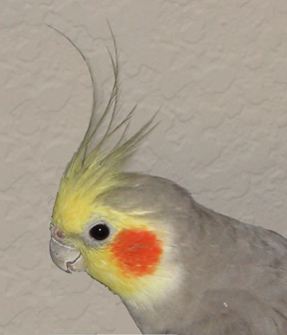
Forbidden Phrases
“I DON’T KNOW.”
“NO.”
“WHY DO YOU NEED TO KNOW?”
“THAT’S AGAINST COMPANY POLICY.”
“YOU’RE WRONG.”
“YOU’LL HAVE TO.”
“THAT’S NOT MY JOB.”
“WE’VE NEVER DONE IT THAT WAY.”
Notes:
Ask for reason’s why you quit doing business with a company.
Ask for reason’s why you are loyal to a particular company.

Slide 13

Keeping Your Customers
Never take them for granted
Stay in touch
Stress benefits of your product
Ask them if they are happy—if not, FIX IT NOW
Notes:
A customer that says their unhappy is doing you a favor.
Current customers account for the vast majority of your sales and revenue. Most companies focus their marketing attracting new customers and not keeping the ones that account for 80% of your profit.

Slide 14

Handling Complaints
Don’t argue
Apologize even if you’re not wrong
Restate problem
Give time frame to resolution
If you can’t meet time, call and extend
Let them know you care and that you are involved
Notes:
Example of the customer that complained about service call two years later and wanted a refund.

Slide 15
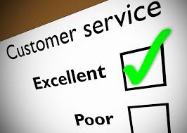
Customer Service Tips
Answer the phone
No voice menus--no lengthy holds
Resolve problems now
Honor your time frames
Complaints are your friend—you get to show how good you really are

Slide 16
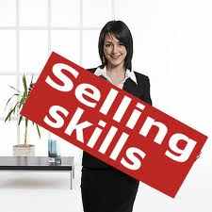
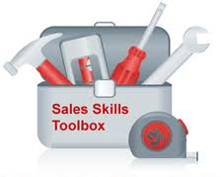
The 7 Steps To A Sale
Planning & Preparation
Introduction or Open
Questioning
Presentation
Overcoming Objections
Closing
After Sales Follow Up

Slide 17
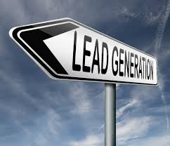
Powerful Prospecting Tips
Prospecting for new business should be done:
Daily.
With Focus.
Routinely.
Organized (Star Sales People).
Take Good Notes.
With the right mind set.

Slide 18
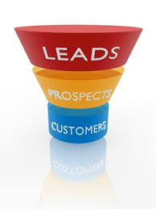
Powerful Prospecting Tips
When Prospecting:
Develop an outline, practice the script until it sounds smooth and natural.
Avoid the temptation to sell over the phone. Your objective is to gather information and make the appointment.

Slide 19


Developing Excellent Sales Skills
Preparing for the Sales Call.
Conducting research on the industry and organization.
Planning the Sales Interview.
Having the proper collateral.
Appearance.

Slide 20
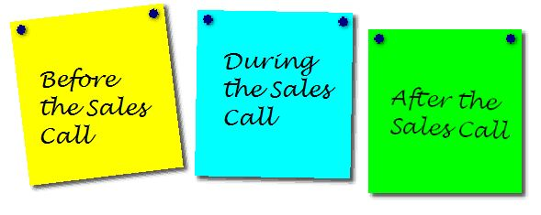
Conducting the Sales Call
Introduction.
Rapport Building.
Selling Techniques (D, C, V, B).
Presentation of Information.
Objection Handling Techniques.
Closing.
Scheduling Follow Up.

Slide 21
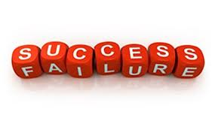
Tips for Successful Selling
You have just a few seconds to make an initial impression be it in person or on the phone.
Maintain an attitude that you are seeking to help your prospect meet a need or solve a problem, rather than force the sale of a product or service.
Know your product and be enthusiastic about it! If you’re not enthusiastic, your prospect certainly won’t be.

Slide 22
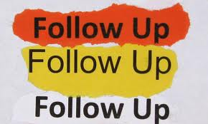
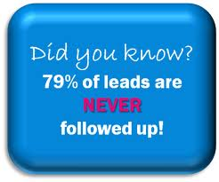
After Sales Call Follow Up
Follow-up consistently
Keep a tickler file
Keep your promised dates
Send correspondence about solutions to their problems
Follow-up, follow-up, follow-up
Notes:
How will you follow up on Prospects and Suspects. Software. What programs and methods are you going to use. E-mails.

Slide 23

Objections-Your Best Friend
Objections are the client telling you how to sell them.
Restate the objection.
Answer in terms of your product’s benefits.
Move on.
OBJECTION HANDLING WORKSHEET
Notes:
Show worksheet. Also suggest to do in business with employees.

Slide 24
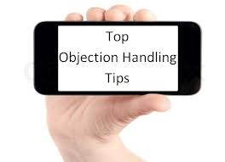
Objection Handling Techniques
Smoke out all important objections.
See the objection as a question.
Agree with the customer about something.
Admitting to the Objection.

Slide 25
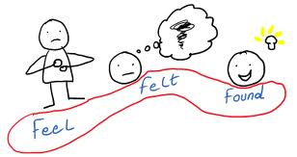
Objection Handling Techniques
Feel/Felt/Found
I know how you feel.
Other customers have felt the same way.
I’ll show you what our customers have found.
Agree/Add/Explain
Listen and confirm.
Align with the customer before redirecting.
Explain why and how the situation can be changed or altered.

Slide 26


Closing the Sale
The Close- In the Mind of a Salesperson
Why are some salespeople afraid to ask for a sale?
Fear of Rejection
Don’t like asking for money
THE CLOSE: IN THE MIND OF A SALES PERSON

Slide 27

Closing the Sale
Are you ready to close?
Many salespeople are fearful of closing.
Remember that your goal is to help your customer achieve results.
Following the initial steps in the sales process will help you prepare for the close.

Slide 28
Closing the Sale
Is the Sales Process ready for the Close?
The close should not proceed until the salesperson has a clear understanding of several of the customer’s needs and how his or her products can fill that need.
The customer should agree with several of the needs and benefits illustrated through the sales process.
Remember– the results of the questioning and recommendation phases of your sales call will directly influence the success of your close.
IS THE SALES PROCESS READY FOR THE CLOSE?

Slide 29

Closing the Sale
The Close
Remember that you are providing a solution that will ultimately help your customer.
If you believe in your products and recommendations, closing should become a natural part of the sales process.
By closing the sale, you are simply asking the customer to spend money on a solution that will solve their problems!
THE CLOSE

Slide 30
Closing the Sale
How did you do?
A thorough review of the sales call will help you fine tune your selling skills.
Use this self-evaluation process to assess the sales process.
Keep it balanced– no sales call is ever perfect nor is it completely horrible. Be as objective as possible when you evaluate your performance.
HOW DID YOU DO?

Slide 31
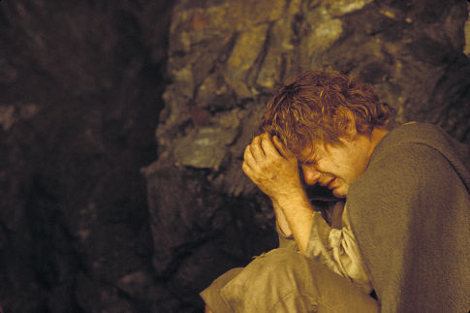
Failure to Close the Sale
Don’t despair
Invite the customer to
shop in your store again or call you for future needs.
Sales are rarely closed on the first call – ask if you can call again.
Practice and experience will help

Slide 32
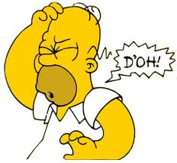
The Four Most Common Sales Mistakes
Not listening to the buyer.
Selling features instead of benefits.
Not asking for the order – CLOSING.
Forgetting to sell to existing customers.

Slide 33

The Beatles

